Slide 1

EE 305 Project 24: Microstrip Patch Antenna
Designed in Ansys HFSS, radiating at 3 GHz.
By: Aryan Rastogi 190002007
Jenish Shah 190002026
Lokinder Singh 190003034
Vardhan Paliwal 190002065
Group
20

Slide 2
Table of Contents
Introduction to Antennas and Microstrip Patch Antenna
Structure of Microstrip Patch Antenna
Applications
Basic Principles of Operation
Feed Techniques
Advantages and Disadvantages
Parameters
Modelling in HFSS
Structural Parameters
Parameter Calculation
Design
Plots
Future Scope
Conclusion
References

Slide 3
What is an Antenna?
Antennas are key components of any wireless system.
Antenna is one type of transducer that converts the electrical energy into the electromagnetic energy in form of electromagnetic waves.
Antennas are required by any radio receiver or transmitter to couple its electrical connection to the electromagnetic field.
Most antennas are resonant devices, which operate efficiently over a relatively narrow frequency range.
An antenna must be tuned to the same frequency band that the radio system to which it is connected operates in, otherwise reception and/or transmission will be impaired.

Slide 4
What is a Microstrip Patch Antenna?
In its most basic form a Microstrip patch antenna consists of a radiating patch on one side of a dielectric substrate which has a ground plane on the other side.
It was invented by Bob Munson in 1972.

Slide 5
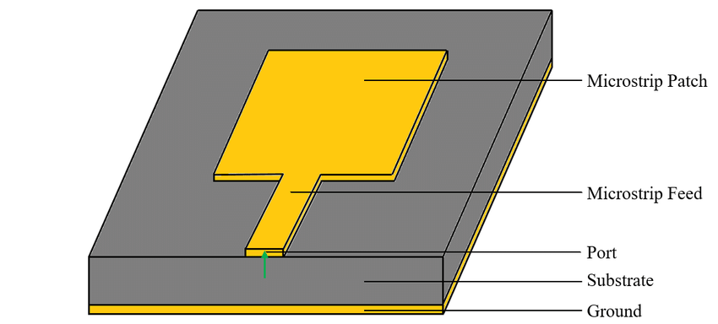
Structure of
Patch
Microstrip Line Feed
Dielectric Substrate
Ground Plane
Port
Microstrip Patch Antenna

Slide 6
Applications
✓ Used in mobile satellite communication system.
✓ Used in aircraft, spacecraft & missiles
✓ Direct broadcast television (DBS).
✓ GPS system.
✓ Telemetry & telemedicine
✓ Radar application

Slide 7
Basic Principles of Operation
The patch acts approximately as a resonant cavity (short circuit walls on top and bottom, open-circuit walls on the sides).
In a cavity, only certain modes are allowed to exist, at different resonant frequencies.
If the antenna is excited at a resonant frequency, a strong field is set up inside the cavity, and a s strong current on the (bottom) surface of the patch. This produces radiation (a good antenna)

Slide 8
Feed Techniques
Micro strip Line Feed: In this type of feed technique, a conducting strip is connected directly to the edge of the microstrip patch. The conducting strip is smaller in width as compared to the patch and this kind of feed arrangement has the advantage that the feed can be etched on the same substrate to provide a planar structure.
Coaxial Feed: The center of the coaxial connector is soldered to the patch.
Aperture Coupled Feed : In this type of feed technique, the radiating patch and the microstrip feed line are separated by the ground plane
Proximity Coupled Feed:This type of feed technique is also called as the electromagnetic coupling scheme.

Slide 9
Advantages
• Light weight and low volume.
• Low profile planar configuration which can be easily made conformal to host surface.
• Low fabrication cost, hence can be manufactured in large quantities.
• Supports both, linear as well as circular polarization.
• Can be easily integrated with microwave integrated circuits (MICs).
• Capable of dual and triple frequency operations.
• Mechanically robust when mounted on rigid surfaces.

Slide 10
Disadvantages
• Narrow bandwidth
• Low efficiency
• Low Gain
• Extraneous radiation from feeds and junctions
• Poor end fire radiator except tapered slot antennas
• Low power handling capacity.
• Surface wave excitation

Slide 11
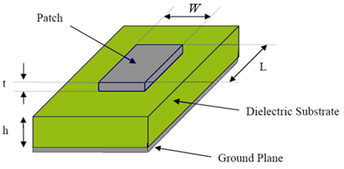
Parameters of
Micro-Strip Patch Antenna
L = Length of the micro strip patch element
W = Width of the micro strip patch element
t = Thickness of patch
h = Height of the dielectric substrate

Slide 12
Modelling in Ansys HFSS
The following materials are chosen for the Antenna design:
Ground: Copper Sheet
Substrate: FR4-Epoxy
Patch and Feed: Copper Sheet
Radiating Boundary: Vacuum

Slide 13
Parameters
Ground:
Copper Sheet of thickness 35 µm
Dimensions= 33mm x 40mm
Substrate:
FR4-Epoxy Layer of relative permittivity of 4.4
Thickness = 1.6mm
Dimensions= 33mm x 40mm
Patch:
Copper Sheet of thickness 35 µm
Dimensions= 23.4mm x 30.4mm (L x W)
Feed:
Copper Sheet of thickness 35 µm
Dimensions= 4.8mm x 0.75mm (L x W)

Slide 14
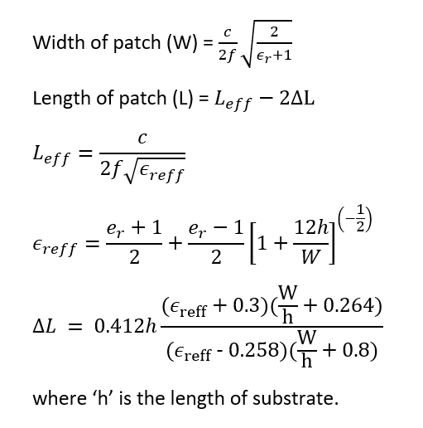
Calculation of Parameters
Patch:
Width of patch = 30.4 mm
Length of the patch = 23.4mm
Effective Relative Permittivity = 4.03
Effective Length(L_eff) = 24.9mm
Variation in Length (ΔL) = 0.75mm

Slide 15
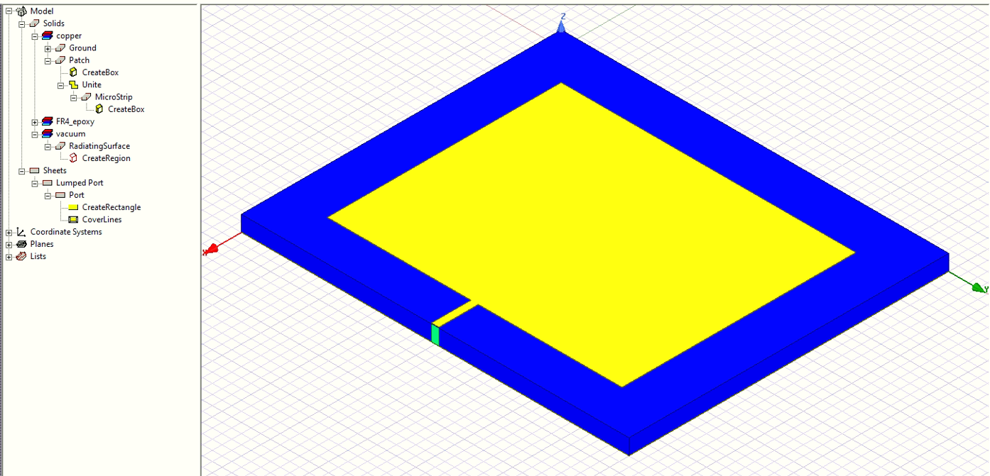
Antenna Diagram

Slide 16
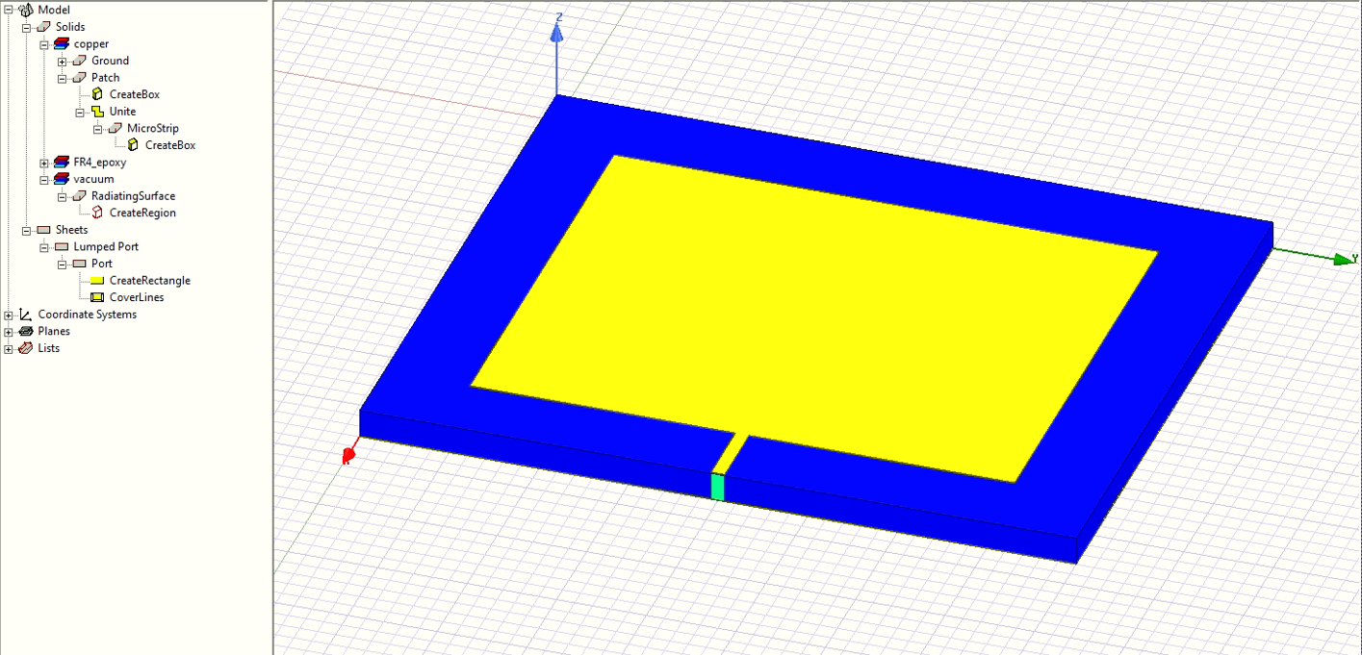
Antenna Diagram

Slide 17
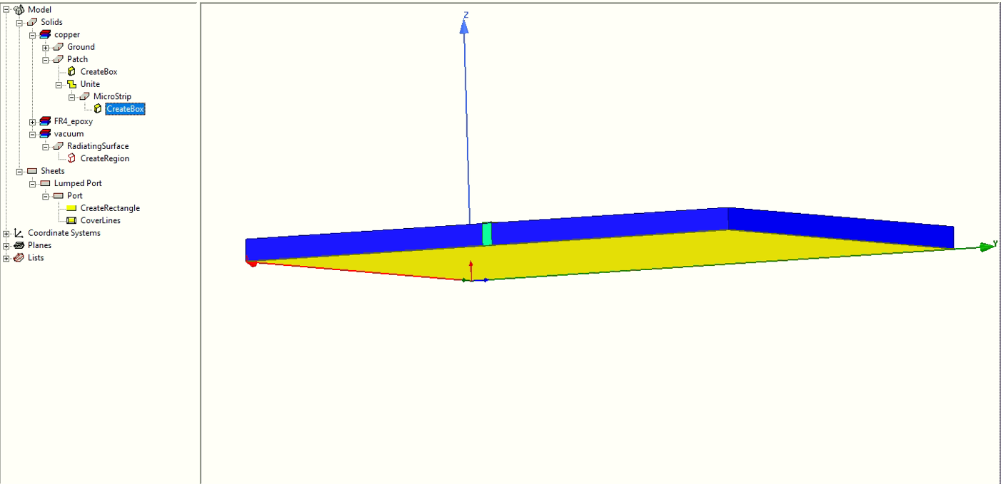
Antenna Diagram

Slide 18
S(1,1)-Parameter Plots
S-Parameters are complex matrix that show Reflection/Transmission Characteristics (Amplitude/Phase) in frequency domain. The numbering conventions for the S-Parameters plots are such that the first number following S represents the ‘port’ where the signal emerges; The second number indicates the ‘port’ where the signal is applied.
Hence, S(1,1) indicates that the input and the output ports are the same.

Slide 19
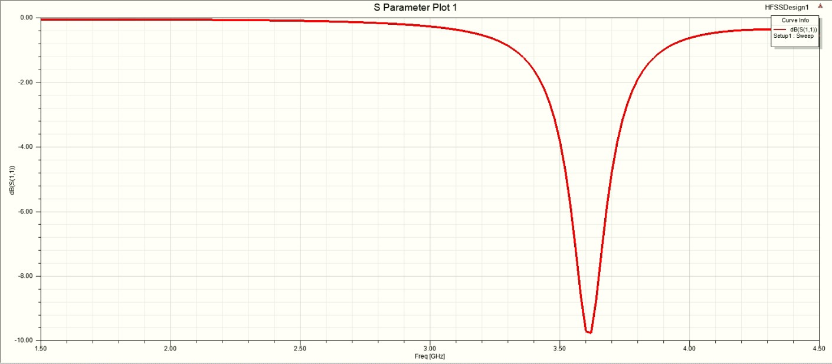
S-Parameter Plots
Patch Length = 19.4 mm

Slide 20
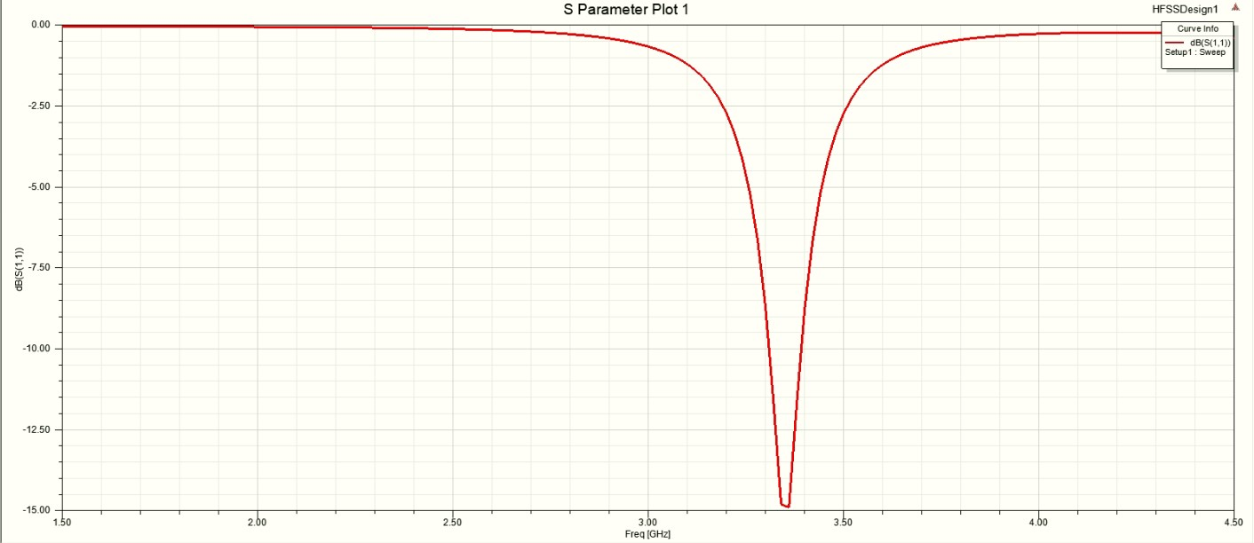
S-Parameter Plots
Patch Length = 21.4 mm

Slide 21
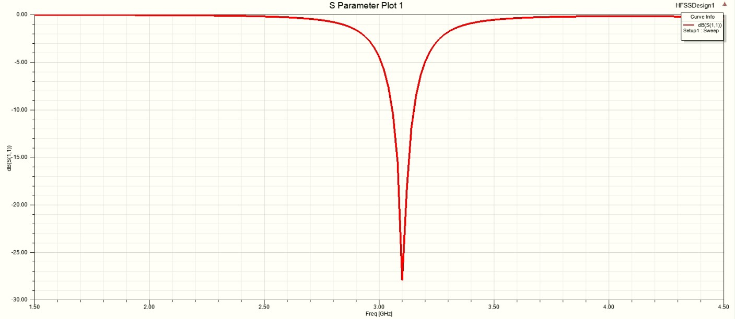
S-Parameter Plots
Patch Length = 23.4 mm

Slide 22
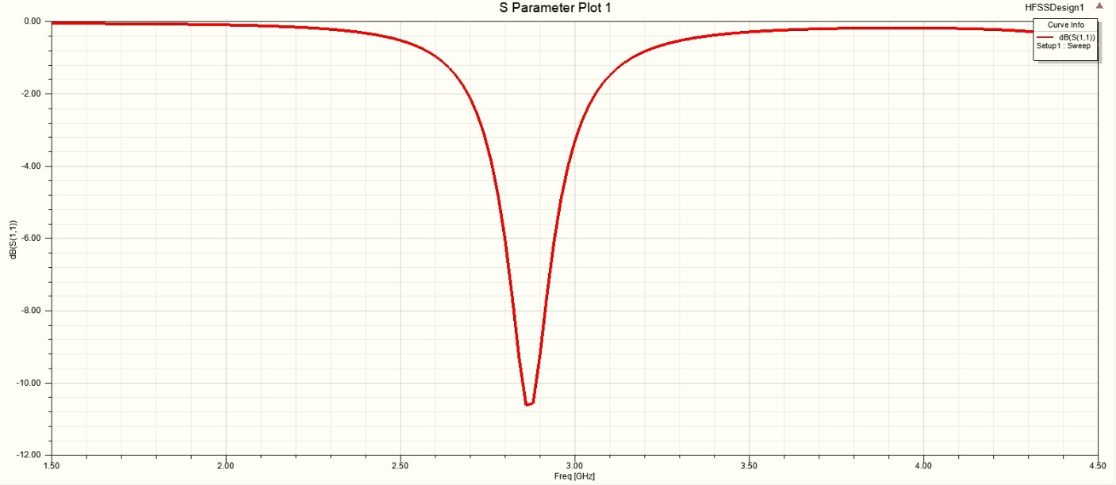
S-Parameter Plots
Patch Length = 25.4 mm

Slide 23
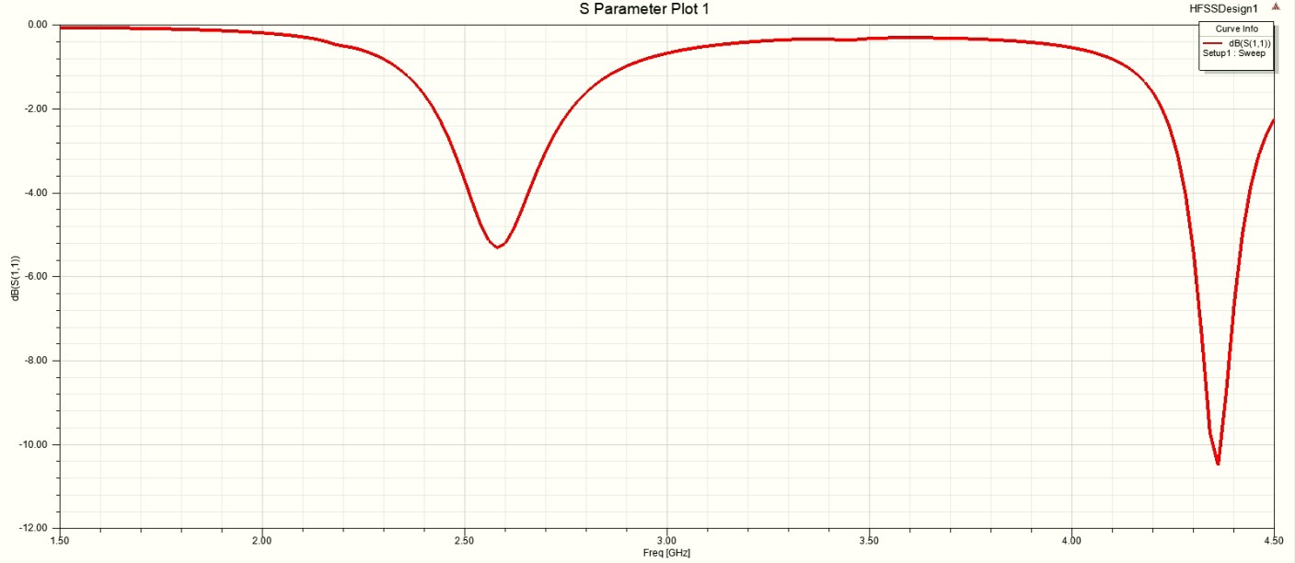
S-Parameter Plots
Patch Length = 27.4 mm

Slide 24
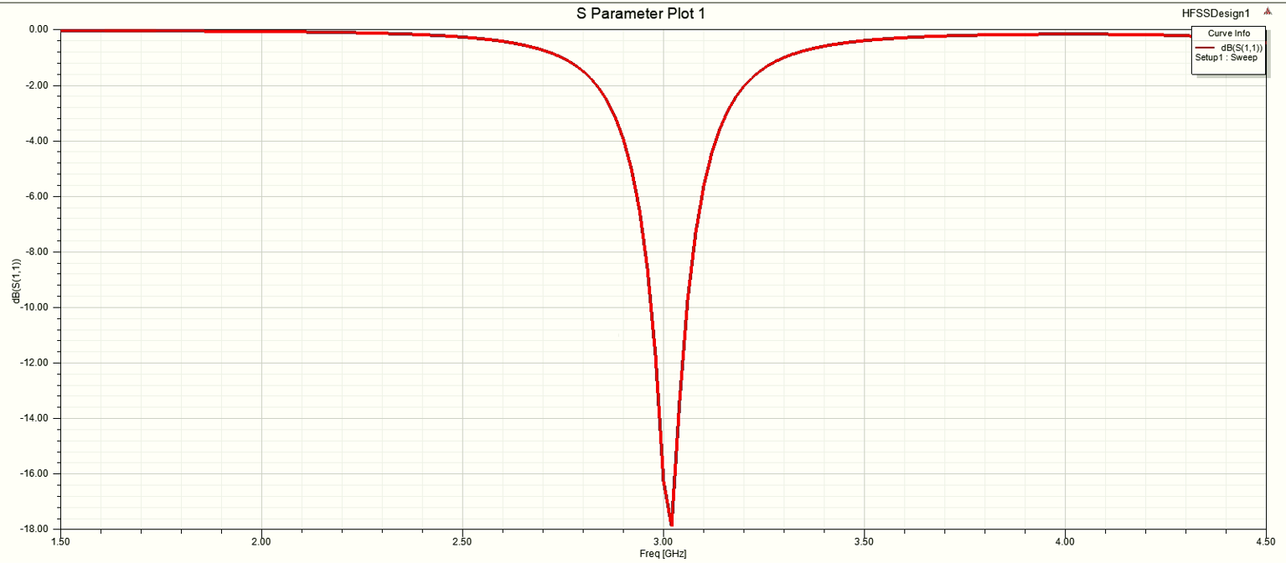
S-Parameter Plots
Patch Length = 24.12 mm (Most optimized)

Slide 25
Smith Chart
Smith Chart represents the plot of complex reflection coefficients overlaid with a normalized characteristic impedance (1 ohm) and/or admittance (1 mho/seimen) grid. It can be used to depict various parameters such as Reflection coefficients, Scattering parameters, Constant gain contours etc.

Slide 26
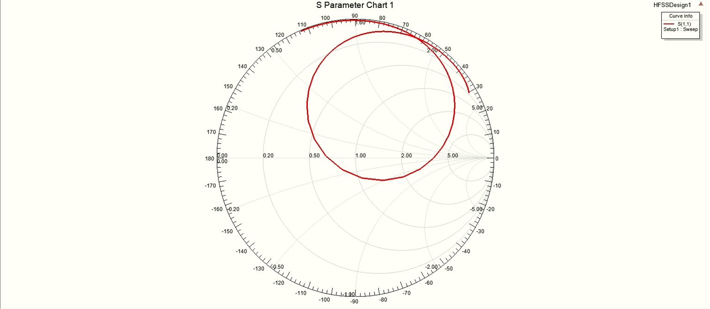
Smith Chart

Slide 27
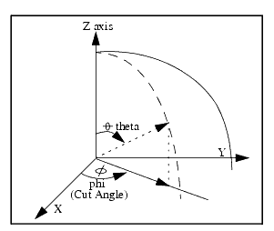
3D Polar Plot
3D Polar Plot is used for visualizing functions defined on a disk. The data provided for the plot appears to be sampled on a spherical grid. Hence, in order to visualize the data, we intend to represent it as a surface to read it properly.
Figure depicting the angles Phi ɸ and Theta θ

Slide 28
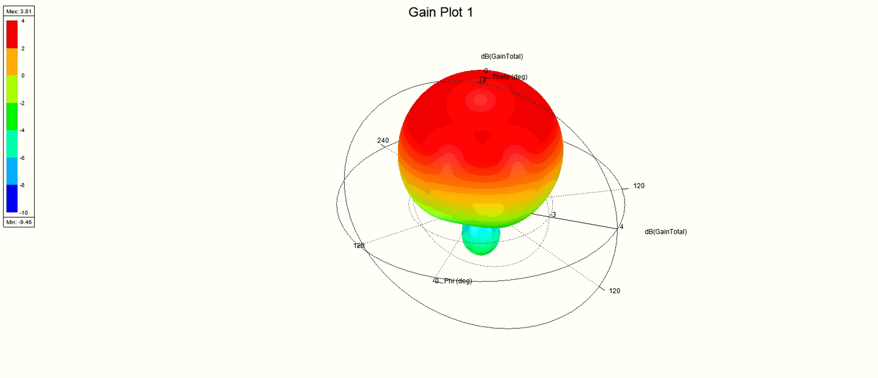
Far Field Plots: 3D Polar Plot
f = 3 GHz

Slide 29
Radiation Plot
The energy radiated by an antenna is represented by the Radiation pattern of the antenna. Radiation Patterns are diagrammatically represented as the distribution of radiated energy into space, as a function of direction away from the said antenna.

Slide 30
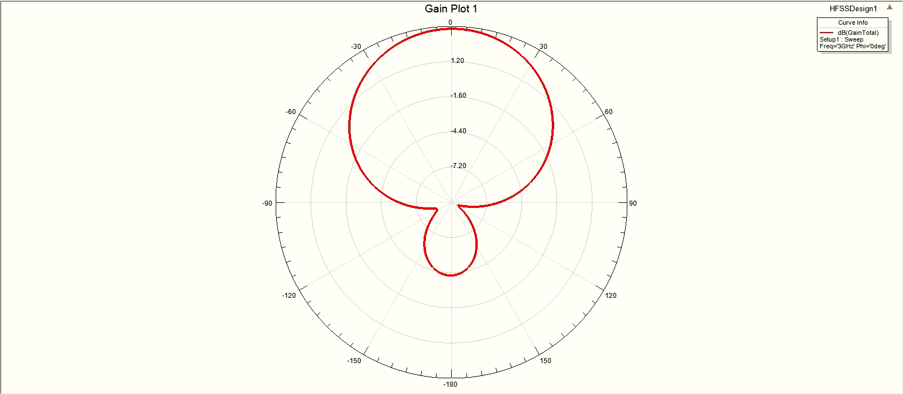
Far Field Plots: Radiation Plot - Theta Angle Sweep

Slide 31
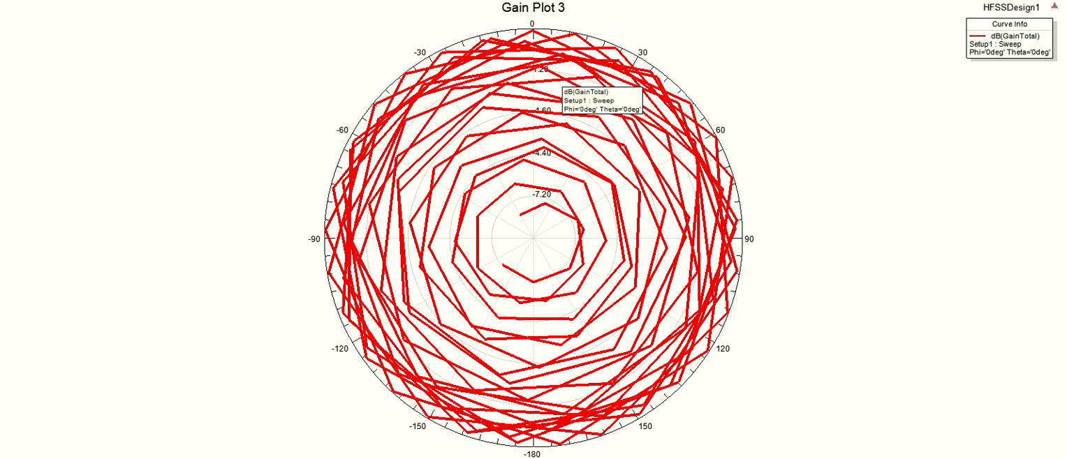
Far Field Plots: Radiation Plot - Frequency Sweep

Slide 32
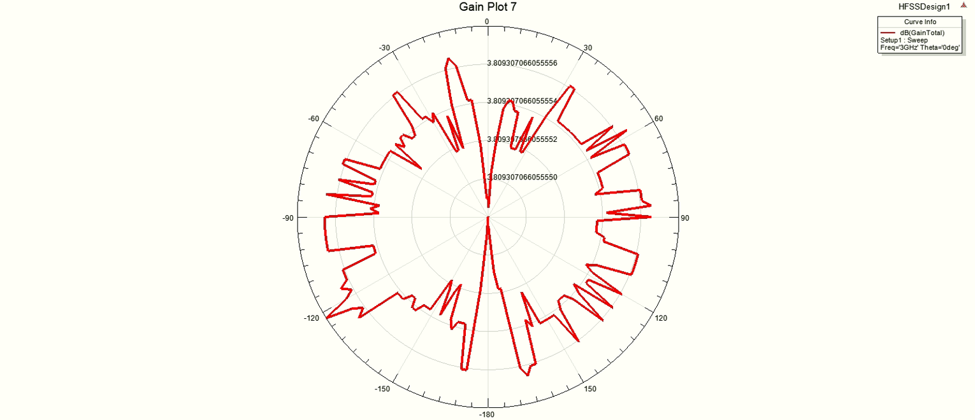
Far Field Plots: Radiation Plot - Phi Angle Sweep

Slide 33
Total Gain
Antenna gain is defined as the maximum radiation intensity produced by the antenna compared to that given by a lossless isotropic radiator supplied with the same level of power. It is a key performance number which combines an antenna’s directivity and electrical efficiency. In a transmitting antenna, the gain describes how well the antenna converts input power into radio waves headed in a specified direction. In a receiving antenna, the gain describes how well the antenna converts radio waves arriving from a specified direction into electrical power.

Slide 34
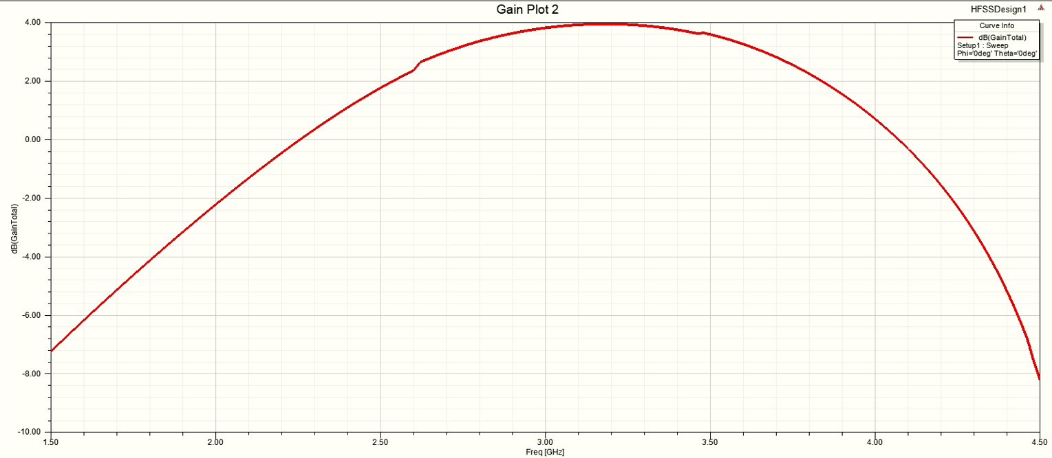
Far Field Plots: Total Gain Plot - Frequency Sweep

Slide 35
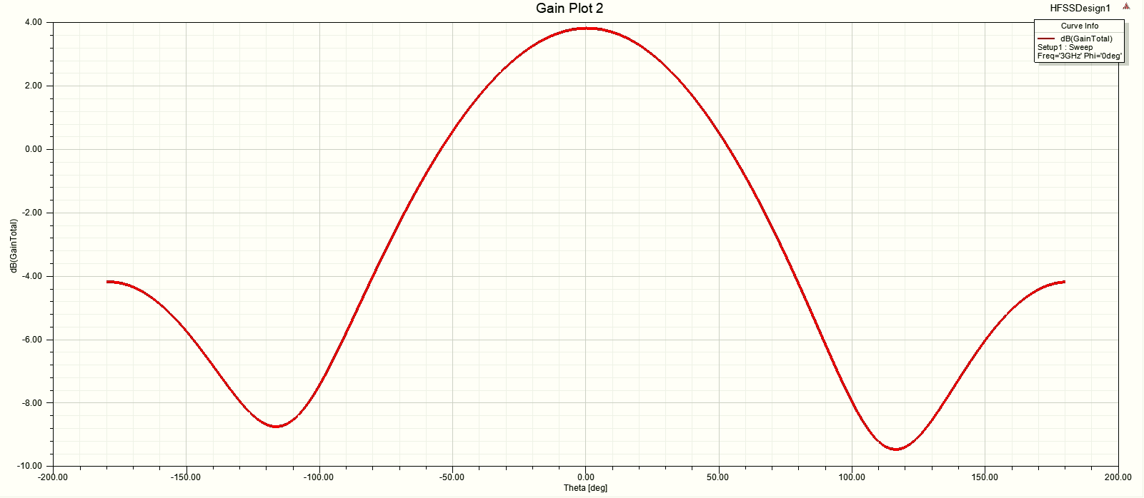
Far Field Plots: Total Gain Plot - Theta Angle Sweep

Slide 36
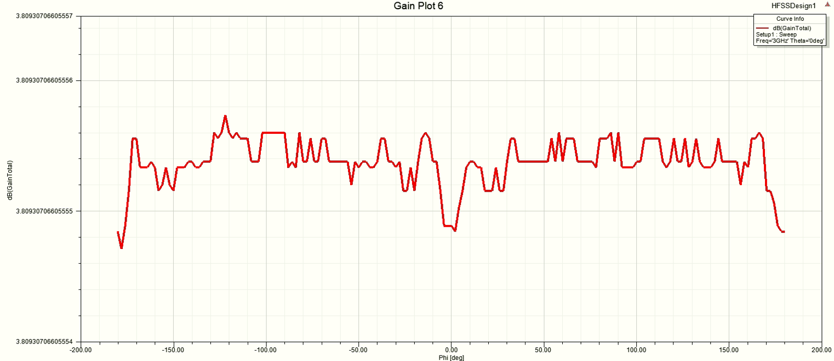
Far Field Plots: Total Gain Plot - Phi Angle Sweep

Slide 37
Future Scope
Microstrip patch antennas have been of interest for a long time due to their low profile, low cost, easy printability, and fabrication, as well as the capability of being embedded within other devices. However, there are many disadvantages associated to it, such as low gain and narrow bandwidth.
We can Increase Mircrostrip Patch Antenna’s Bandwidth by:-
Increasing substrate height
Including partial ground
Also, the optimized response was obtained by using parameters slightly different from the theoretical ones. This can be due to various extrinsic factors and material properties, which must be considered while designing the same.
Experimental radiation patterns of the constructed antenna could
not be obtained and compared with the theoretical patterns. Though we were able to simulate patch antennas, but were unable to fabricate one and compare the practical and simulated results.

Slide 38
Conclusion
The simulation of microstrip patch antenna is carried out.
The various methodology necessary for simulation are done.
The substrate and patches are created.
The radiation pattern are observed. Rectangular patch antenna at 3 GHz is designed on Ansys HFSS.
The designed antenna is suitable for mobile communication, cell phone antennas etc.
The simulation gave results good enough to satisfy our requirements to fabricate it on hardware which can be used in various applications.

Slide 39
References
https://en.wikipedia.org/wiki/Antenna_(radio)
https://en.wikipedia.org/wiki/Microstrip_antenna
Microstrip Patch Antennas: By Kai Fong Lee, Kwai Man Luk, Hau Wah Lai
Practical Microstrip and Printed Antenna Design: By Anil Pandey
Microstrip Patch Antenna Design: G. Garg, P. Bhartia, I. Bahl, A. Ittipiboon
Nandalal et al. : https://dx.doi.org/10.37622/IJOO/14.1.2020.101-108
NPTEL Playlist on Antennas by Prof. Girish Kumar (IIT-B)
Werfelli et al. : http://dx.doi.org/10.1109/ATSIP.2016.7523197

Slide 40
Thank You

